Slide 1
F
I
R
S
T
C
O
R
N
A
N
I
T
H
I
S
12.1-6
A free CD of this message will be available following the service
It will also be available for podcast later this week at calvaryokc.com

Slide 2
Oncesavedalwayssaved
Baptismoftheholyspirit
Withtheevidenceof
speakingintongues
O
A
N
S
12.1-6
I
I
F
I
R
S
T
C
R
N
T
H

Slide 3
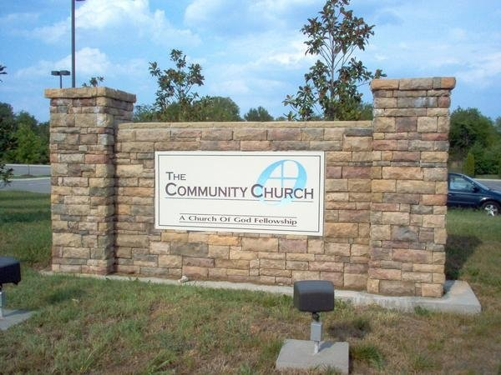
The First
Church
of the
baptismoftheHolySpiritwiththeevidenceofspeakingintongues
O
A
N
S
12.1-6
I
I
F
I
R
S
T
C
R
N
T
H

Slide 4
This is a story about four people named
Everybody, Somebody, Anybody and Nobody.
There was an important job to be done
And Everybody was sure that Somebody could do it.
O
A
N
S
12.1-6
I
I
F
I
R
S
T
C
R
N
T
H

Slide 5
Anybody could have done it,
but Nobody did it.
Somebody got angry about that,
because it was Everybody's job.
Everybody thought Anybody could do it,
but Nobody realized that Everybody wouldn't do it.
O
A
N
S
12.1-6
I
I
F
I
R
S
T
C
R
N
T
H

Slide 6
It ended up that Everybody blamed Somebody when Nobody did what Anybody could have done.
O
A
N
S
12.1-6
I
I
F
I
R
S
T
C
R
N
T
H

Slide 7
Spiritual gifts - pneumatikos – literally “spirituals”
Ignorant - agnoeō – without knowledge (agnostic)
O
A
N
S
12.1-6
I
I
F
I
R
S
T
C
R
N
T
H

Slide 8
1. Rom. 11:25 - regarding God's plan for Israel and the Church
2. 1 Thess. 4:13 - regarding those who have fallen “asleep”
3. 1 Cor. 12:1 - regarding the “spirituals”
O
A
N
S
12.1-6
I
I
F
I
R
S
T
C
R
N
T
H

Slide 9
Dumb - aphonos – voiceless
O
A
N
S
12.1-6
I
I
F
I
R
S
T
C
R
N
T
H

Slide 10
Gifts – Charismata, plural of charisma – literally “grace things”
O
A
N
S
12.1-6
I
I
F
I
R
S
T
C
R
N
T
H

Slide 11
Ministries - KJV, administrations; NIV, service
diakonia – deacon
O
A
N
S
12.1-6
I
I
F
I
R
S
T
C
R
N
T
H

Slide 12
Activities - energēma – energy
NASB, effects
O
A
N
S
12.1-6
I
I
F
I
R
S
T
C
R
N
T
H

Slide 13
Trinity
Different gifts (v. 4, the Spirit)
Different areas (v. 5, the Lord)
Different Activities - effects (NASB) (v. 6 the Father)
O
A
N
S
12.1-6
I
I
F
I
R
S
T
C
R
N
T
H

Slide 14
Enhanced (teaching)
Extraordinary (healing)
Endless (giving)
Episodic (miracles)
O
A
N
S
12.1-6
I
I
F
I
R
S
T
C
R
N
T
H

Slide 15
Cessationism - The belief that the miraculous gifts of the Spirit - such as healing, tongues, and prophetic revelation, etc. - pertained to the apostolic era only, served a purpose that was unique to establishing the early church, and passed away before the canon of Scripture was closed
O
A
N
S
12.1-6
I
I
F
I
R
S
T
C
R
N
T
H

Slide 16
Continuationism - The belief that the miraculous gifts of the Holy Spirit taught in the bible - such as prophecy, tongues, interpretation of tongues, healings, miracles, etc. - have not ceased and are available for the believer today
O
A
N
S
12.1-6
I
I
F
I
R
S
T
C
R
N
T
H

Slide 17
Cessationism – the “sign” gifts have ceased
Continuationism - the “sign” gifts have continued
O
A
N
S
12.1-6
I
I
F
I
R
S
T
C
R
N
T
H

Slide 18
Cessationism
Continuationism
“Natural” Gifts
“Miraculous” Gifts
balance
O
A
N
S
12.1-6
I
I
F
I
R
S
T
C
R
N
T
H

Slide 19
Rom. 12:6 - Having then gifts then differing according to the grace that is given to us, let us use them …
Heb. 10:24 - And let us consider one another in order to stir up love and good works …
O
A
N
S
12.1-6
I
I
F
I
R
S
T
C
R
N
T
H

